Slide 1
Echo ‘G5T4’;
Final Presentation
Members: Jaslyn, See Hoe, Leonard, Serene, Yi Bing

Slide 2
SCHEDULE
01
BUG METRIC
02
TABLE OF CONTENTS
03
USE OF GIT
04
OTHERS

Slide 3
01
SCHEDULE

Slide 4
Schedule - Planned Timeline
12/10/2019 - 25/10/2019
Features: Drop Bid, Drop Section, View Bidding Results, JSON (Authenticate, Bootstrap, Dump, Start, Stop, Update Bid, Delete Bid, Drop Section)
09/11/2019 - 17/11/2019
Debugging and Testing (Local and Cloud)
14/9/2019 - 27/9/2019
Features: Login & Bootstrap
Iteration 4 (Serene)
Iteration 2 (Leonard)
Iteration 6 (Jaslyn)
Iteration 1 (Jaslyn)
Iteration 3 (See Hoe)
Iteration 5 (Yi Bing)
28/9/2019 - 11/10/2019
Features: Bidding & Clearing (round 1 and 2)
26/10/2019 - 08/11/2019
Features: JSON Bid Status. Testing and Debugging (Local and Cloud)
18/11/2019 - 19/11/2019
Final Presentation
Notes:
Visual representation

Slide 5
Schedule - Actual Timeline
12/10/2019 - 25/10/2019
Features: Drop Bid, Drop Section, View Bidding Results, JSON (Authenticate, Bootstrap, Dump, Start, Stop, Update Bid, Delete Bid, Drop Section)
09/11/2019 - 17/11/2019
Debugging and Testing (Local and Cloud) (Delayed Deployment, but still completed within the iteration)
14/9/2019 - 27/9/2019
Features: Login & Bootstrap
Iteration 4 (Serene)
Iteration 2 (Leonard)
Iteration 6 (Jaslyn)
Iteration 1 (Jaslyn)
Iteration 3 (See Hoe)
Iteration 5 (Yi Bing)
28/9/2019 - 11/10/2019
Features: Bidding & Clearing (round 1 and 2)
26/10/2019 - 08/11/2019
Features: JSON Bid Status. Testing and Debugging (Local and Cloud)
18/11/2019 - 19/11/2019
Final Presentation
Notes:
Visual representation

Slide 6
Functionalities
Did not drop any functionalities
Did not implement any additional functionalities
Did not use PHP frameworks
Used Bootstrap v4.3.1 framework for UI via CDN
Notes:
Did you drop any functionalities, implement any additional functionalities, and/or use any frameworks or external libraries? If so what.

Slide 7
Non-programming and Programming hours
 | Jaslyn | See Hoe | Leonard | Yi Bing | Serene
Prog Hrs | 35.5 | 35.5 | 31.5 | 43.5 | 39.5
Non-prog Hrs | 107 | 73 | 87 | 70 | 63
Notes:
Programming Tasks: Every Iteration, Who is assigned what. Show this in a table.
Non-programming Tasks: Daily Updates, Update schedule, Update Bug metric, Update Testcases
Separate Programming tasks & non-programming tasks
Programming tasks -> show task allocation as well as hours spent by each team member

Slide 8
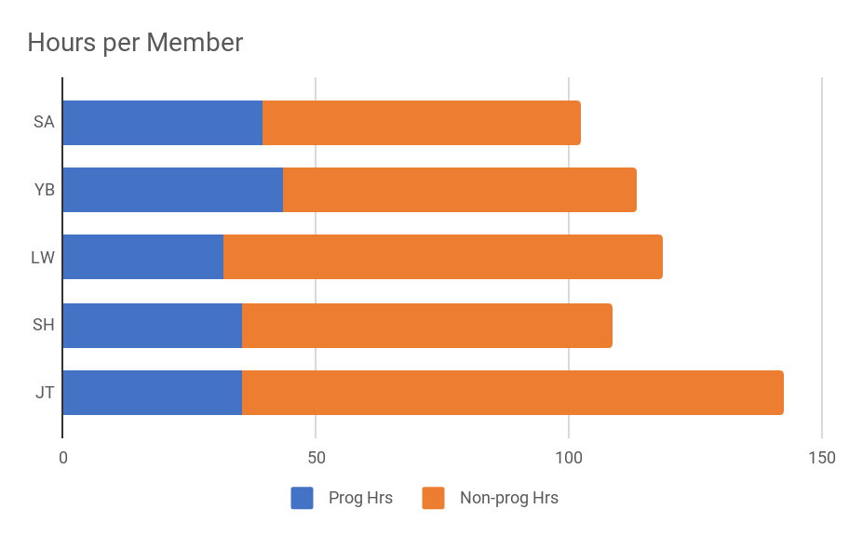
Non-programming and Programming hours
Notes:
Separate Programming tasks & non-programming tasks
Programming tasks -> show task allocation as well as hours spent by each team member

Slide 9
Breakdown of Work
Legend:
Programming Tasks
Non-Programming Tasks
 | Iteration 1
Jaslyn | Documentation Schedule Daily Update
See Hoe & Yi Bing | Database Classes and DAO for Section, Course, Prerequisites Bootstrap for Section, Course, Prerequisites Login Testing and Debugging Bug Metrics Test Cases
Leonard & Serene | Classes and DAO for Bid, Course_completed, Student Bootstrap for Bid, Course_completed, Student Testing and Debugging Bug Metrics Test Cases
 | Iteration 2
Leonard | Documentation Schedule Daily Update Prepare Team for PM Review Landing page, bid homepage, bidding & admin homepage UI
Jaslyn & See Hoe | Round 1 & 2 Starting and Clearing Admin Home Page Testing and Debugging Deployment (Jaslyn) Bug Metrics Test Cases Slides for PM Review
Yi Bing & Serene | Round 1 & 2 Bidding Student Bid Home Page Testing and Debugging Bug Metrics Test Cases Slides for PM Review

Slide 10
Breakdown of Work
Legend:
Programming Tasks
Non-Programming Tasks
 | Iteration 3
See Hoe | Documentation Schedule Daily Update Ensure team is ready for Progress Update
Serene & Jaslyn | Drop Bid JSON Login, Bootstrap, Start, Stop, Update Bid, Dump table, Dump (User), Dump (Bid) Testing and Debugging Bug Metrics Test Cases Slides for Progress Update
Yi Bing & Leonard | View Bidding results Drop Section JSON Drop section, Dump section Testing and Debugging Bug Metrics Test Cases Slides for Progress Update
 | Iteration 4
Serene | Documentation Schedule Daily Update Ensure Team is ready for UAT
Jaslyn & Yi Bing | JSON Bid Status Testing and Debugging: Round 1 Bidding and clearing, Drop Bid, View Bidding Results, JSON Checkers Bug Metrics Test Cases
See Hoe & Leonard | UI for drop section, view bidding status Testing and Debugging: Login, Bootstrap, Drop section, Round 2 bidding and clearing, JSON Checkers Bug Metrics Test Cases

Slide 11
Breakdown of Work
Legend:
Programming Tasks
Non-Programming Tasks
 | Iteration 5
Yi Bing | Documentation Schedule Daily Update Ensure team is ready for Final Presentation
Leonard & Jaslyn | Testing and Debugging for all functions Deployment (Jaslyn) Bug Metrics Test Cases Slides for Final Presentation
Serene & See Hoe | Testing and Debugging for all functions Bug Metrics Test Cases Slides for Final Presentation
 | Iteration 6
Jaslyn | Rehearse for Final Presentation
Yi Bing & See Hoe | Rehearse for Final Presentation
Serene & Leonard | Rehearse for Final Presentation

Slide 12

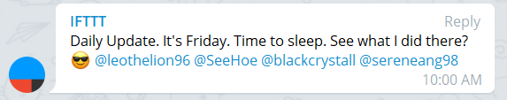
Problems Faced tracking our schedule
Problems:
Members sometimes forgets to update the PM on Daily updates.
PM sometimes forgets to commit Daily updates on time
Solution: Used a telegram bot to remind members to update PM on Daily updates.

Slide 13
02
BUG METRIC

Slide 14
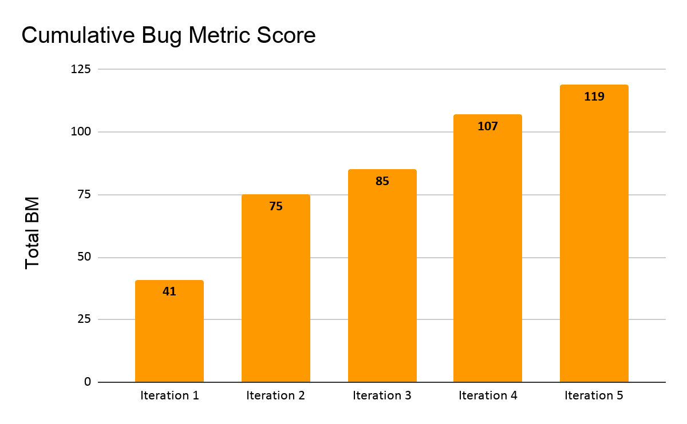
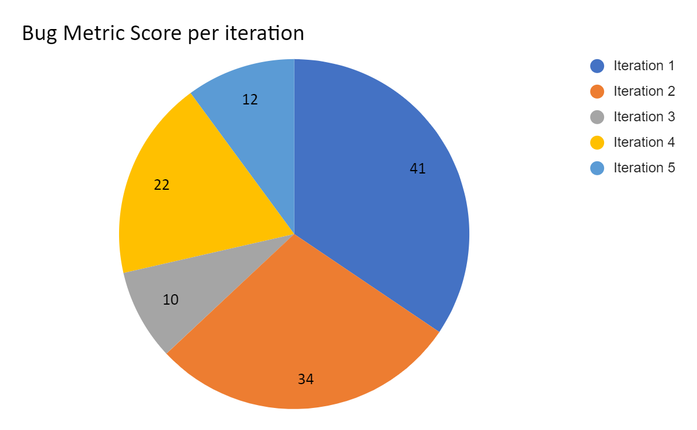
Bug Metrics

Slide 15
Bug Metrics
For bugs with 1 point, they were solved immediately upon detection
For bugs with 5 points and above, PM was informed to schedule a debugging session.
Debugging sessions for the various iterations are as follows:
Iteration 1 | 24/9/2019
Iteration 2 | 5/10/2019
Iteration 3 | 12/10/2019, 24/10/2019
Iteration 4 | 6/11/2019
Iteration 5 | 12/11/19
Notes:
Tell us how you used the metric to fix problems identified.
Give us examples of concrete follow-on actions you took to fix the most severe problems identified by the metric.
What were some of the challenges faced (and how you overcame them) when collecting and using the metric?

Slide 16
Problems Faced
Problems:
Members filled up the sheet for bug log instead of bug metric, thus only 1 sheet was updated instead of both
Members sometimes forget to record bugs on the spot, thus we have to update the bug log very frequently
Solution:
At the end of every debugging session, members have to check if both sheets are filled. We also re-made the sheet to auto update from bug metric to bug log so we only have to fill one sheet out.
Remind members to record bugs every debugging or programming session

Slide 17
03
USE OF GIT

Slide 18








Purposeful naming of Commits

Slide 19
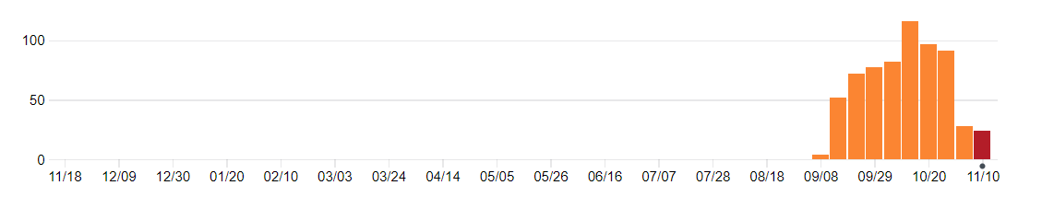
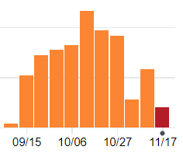
Consistent commits
Peaked in Mid-Oct before UAT
Many rounds of testing after UAT
Notes:
We reached our peak commits around mid october as we did a regression testing and found alot of bugs which we had to fix before UAT.
Our november commits shows an increase as we did another round of testing and fixed all the bugs which were found in UAT

Slide 20
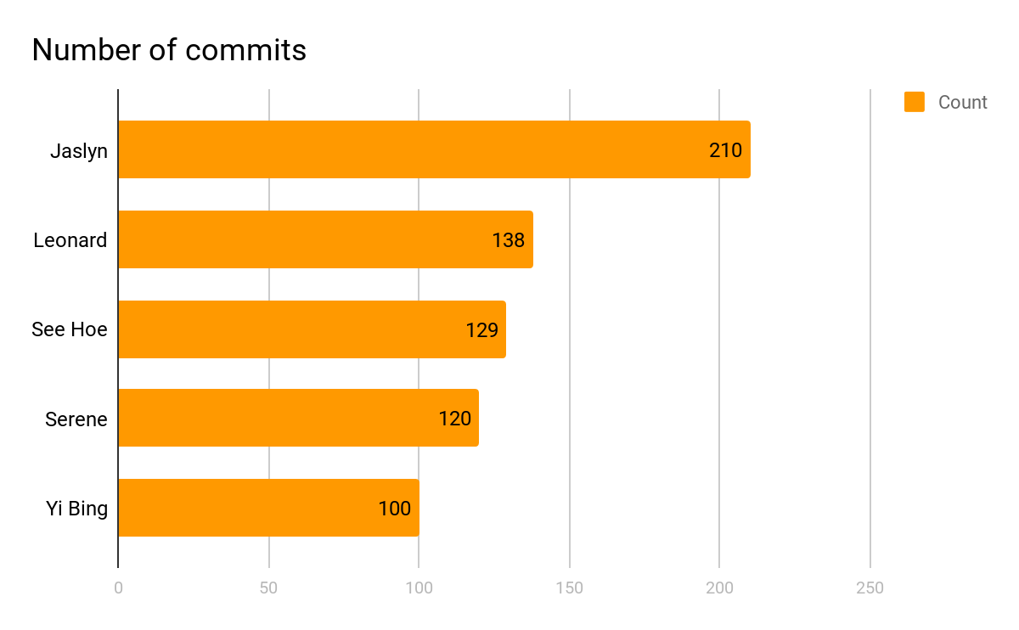
Notes:
Our average number of commits is about 120. My commits are slightly higher and i will justify why later on.

Slide 21
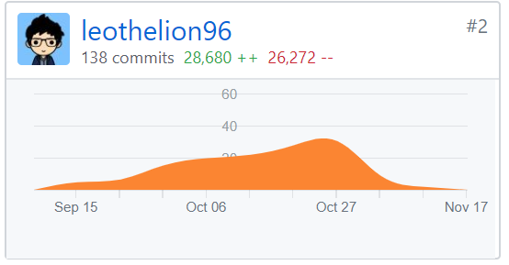
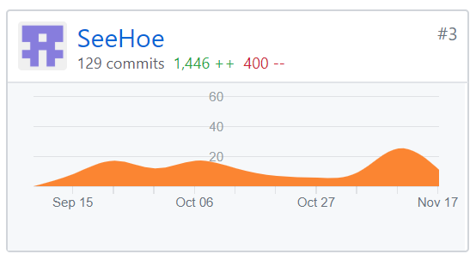
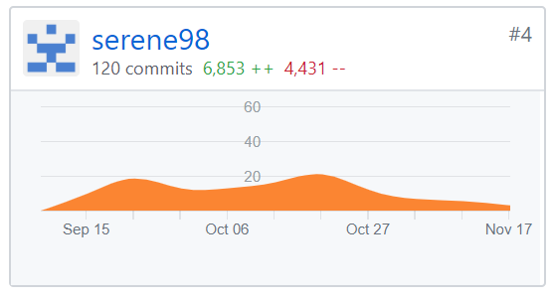
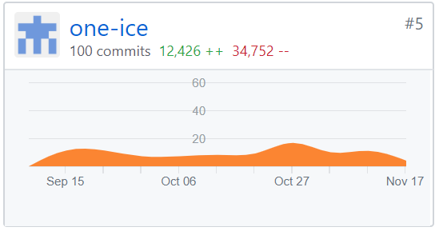
Even commits across members

Slide 22
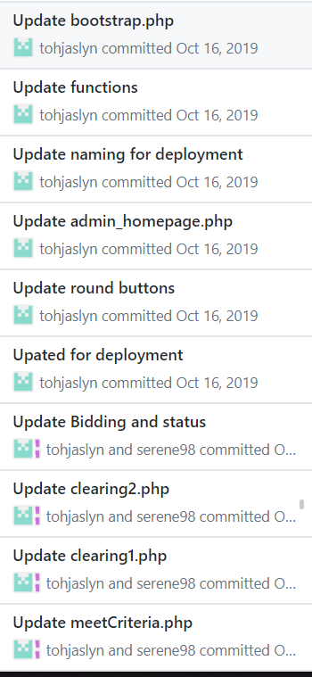
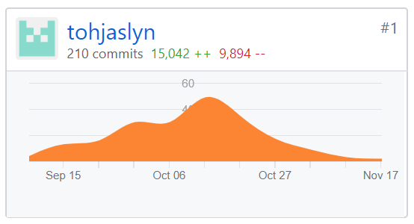
Reason for the unusual high commits - In-charge of Deploying and testing for all 3 Deployments

Slide 23
04
OTHERS

Slide 24
Main Takeaways
Understand the fundamentals to manage a project
Never change code at the very last minute, without much testing
Regression testing with lots of test cases over and over again
Expectation VS Reality

Slide 25
Team Conflicts/Issues/Problems
Week 6, Leonard was sick and he is assigned as a coder. Thus, the rest of the coders have to cover his portion.
We don’t understand JSON so we have to wait till TA session before we could utilise JSON Checkers.
We are amicable people in an amicable team. So there are no conflicts, only amicable discussion

Slide 26
Something Interesting about your Members
Leonard is surprisingly strong at CSS but sometimes can be weak at PHP
See Hoe can be rather forgetful at times, such as forgetting to change his local directory so that Json checkers can run
Jaslyn is able to check code anytime
Yi Bing type only with her index fingers
Serene is very careful with her work

Slide 27
Thank You!

